Slide 1
Indiana’s Attendance Dashboard

Slide 2
Attendance Level-Set

Slide 3
About one quarter of U.S. students qualified as chronically absent.
This number has been rising since the pandemic.
Note: Chronically absent means missing at least 10 percent of school days or about three and a half weeks.
Source: Where Are the Students? image: Flaticon.com

Slide 4
Data show that even after adjusting for socioeconomic status and race, U.S. children who skip more school get significantly worse grades.
Source: Where Are the Students? image: Flaticon.com

Slide 5
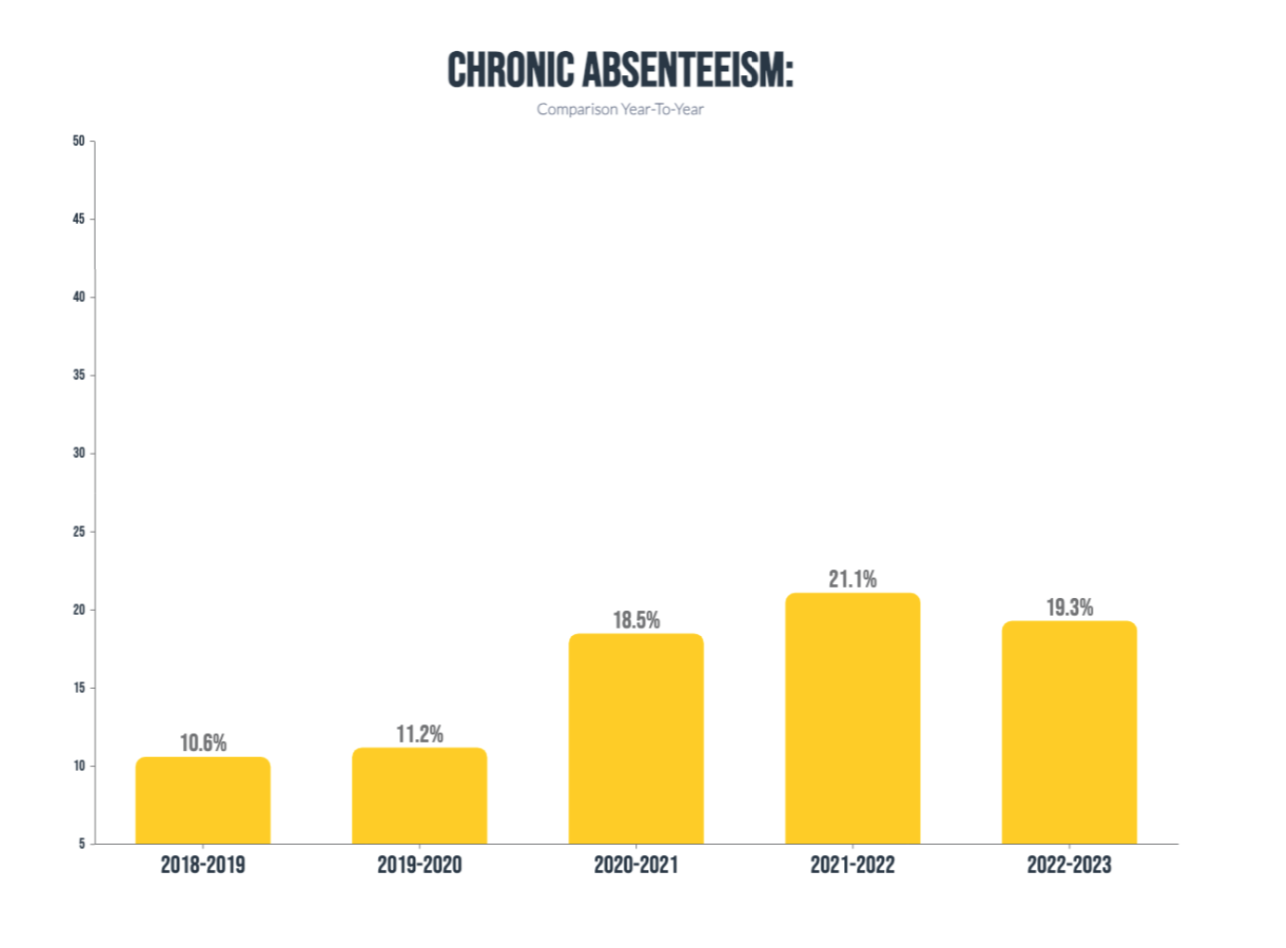
CHRONIC ABSENTEEISM IN Indiana
COVID-19

Slide 6
OTHER KEY DATA POINTS
While Indiana’s chronic absenteeism rate decreased from the 2021-2022 school year to the 2022-2023 school year, it remains over 8% higher than it was before the pandemic (19.3%).
84 Indiana schools have 1 in 2 students who are chronically absent.
Rates of chronic absenteeism are highest amongst students in grades nine through 12, ranging from 21% in grade nine to over 33% in grade 12.
Student populations who experienced the greatest academic impacts in ELA and math following the pandemic also have greater rates of chronic absenteeism.
Black students (30.7%), Hispanic students (24.4%), English learners (20.5%), and students eligible for free and reduced lunch (25.9%).

Slide 7
What Attendance DAta DO We Collect?
Positive Attendance Data
Attendance Codes Collected Include:
In Attendance
Excused Absence
Unexcused Absence
Exempt
Suspended
Attendance collected at 1.0 or .5 day increments.
Expelled
Tardy
Virtual
Virtual Due to Covid

Slide 8
Improving Attendance

Slide 9
Four cases for improving attendance
Graduates Prepared to Succeed (GPS)
Early Warning Indicator
Attendance Dashboard

Slide 10
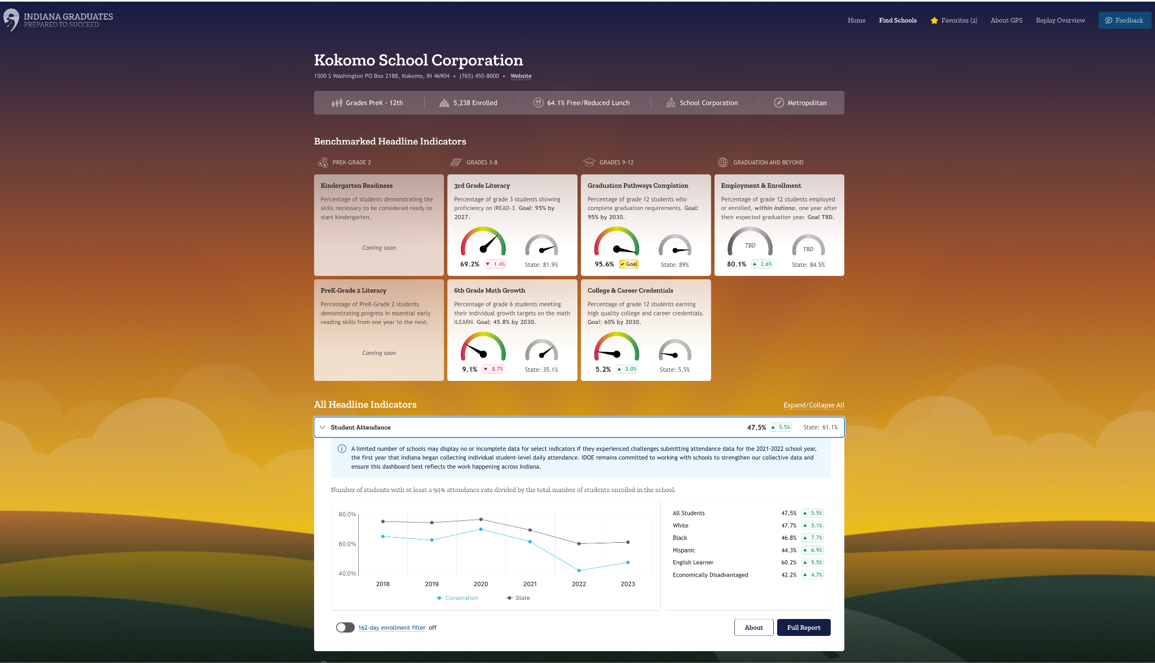
EARLY WARNING DASHBOARD - Under development

Slide 11
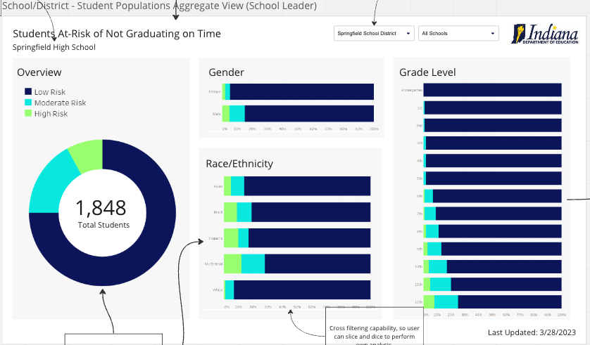
EARLY WARNING DASHBOARD - Under development
Purpose: To develop an Early Warning Dashboard for Indiana schools to use in directing attention and resources to students most at-risk of not graduating. Note: At-risk is defined as having less than an 80% chance of graduating on time using historical data.
Target launch: 2024-2025 SY

Slide 12
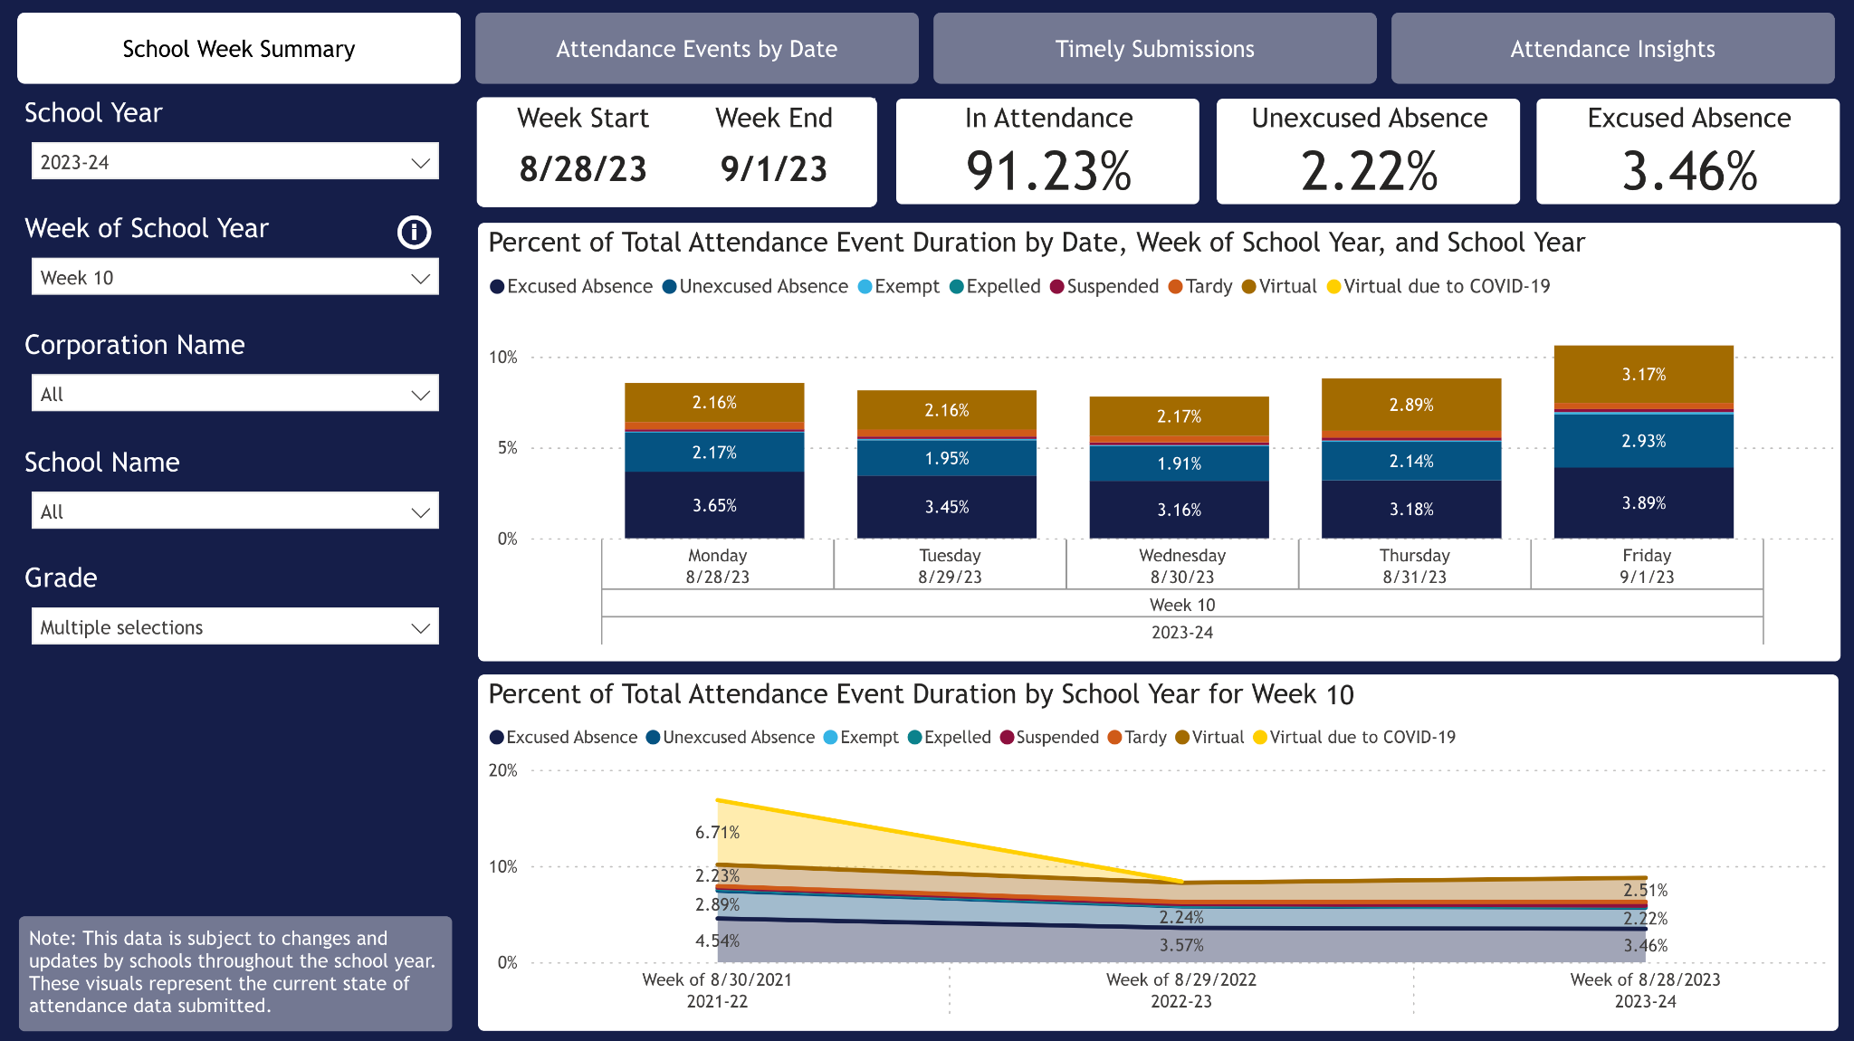
Attendance dashboard - COMING SOON!

Slide 13
Thank you!

